Slide 1


DATA ANALYTICS BOOTCAMP
Book Recommendation System
By Luis Pablo Aiello
Data Analyst Student

Slide 2

Project Overview
This project builds an end-to-end pipeline
Scraping → Cleaning → Feature Engineering → Clustering → Content-Based Recommendation → Streamlit Web App
01
02
03
Scraped data from Goodreads and Open Library to gather information.
Cleaned and merge data to create a unified dataset.
We engineered features from genres and text for the recommendation system.
04
05
06
Apply unsupervised ML concepts
Build content-based recommender
Deploy a Streamlit web app

Slide 3



Data Sources
Goodreads
Open Library
A popular platform for discovering and reviewing books globally.
An expansive online library offering free access to countless book resources.
  Loop over the Best Books Ever list pages.
  Extract:
    Book title & URL
    Author name & URL
    Average rating
    Number of ratings
    Score & votes
    List rank
  For each book page:
    Extract Genres (new layout tags).
    Extract First published year from book details.
  Call search.json with the trending query:
    trending_score_hourly_sum:[1 TO *] -subject:"content_warning:cover" language:eng -subject:"content_warning:cover" -subject:"content_warning:cover"
  Extract:
    Title, author(s)
    Ratings average & count (if available)
    trending_score_hourly_sum
    Work key → build book URL.
  For each work URL:
    Parse the Subjects block as genres.

Slide 4
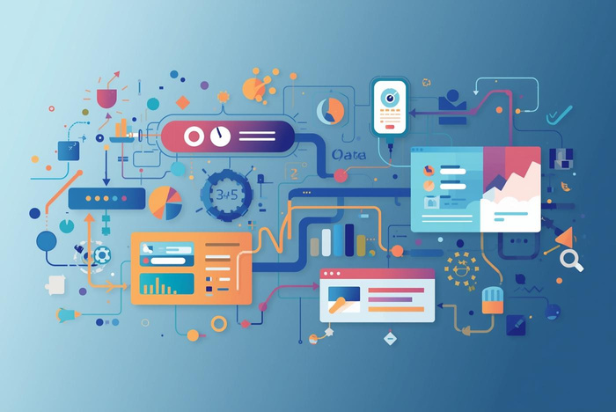
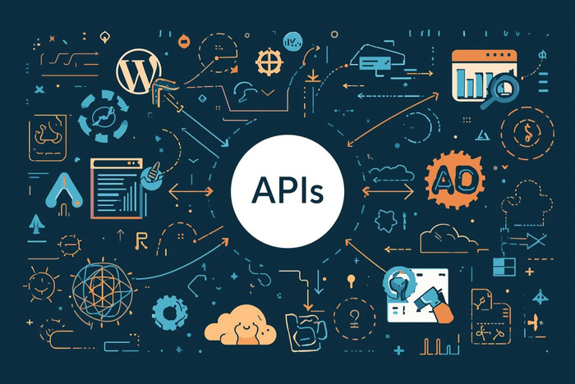
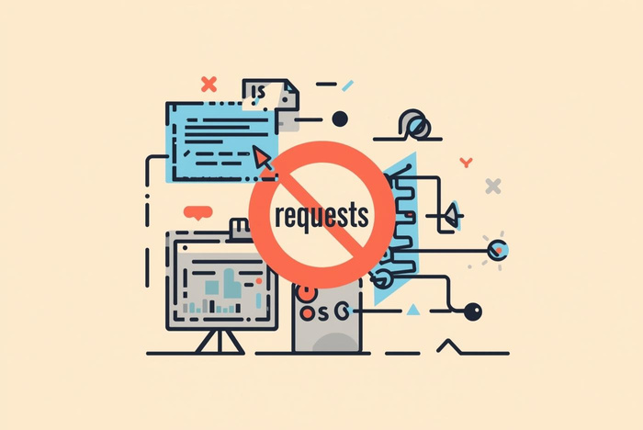
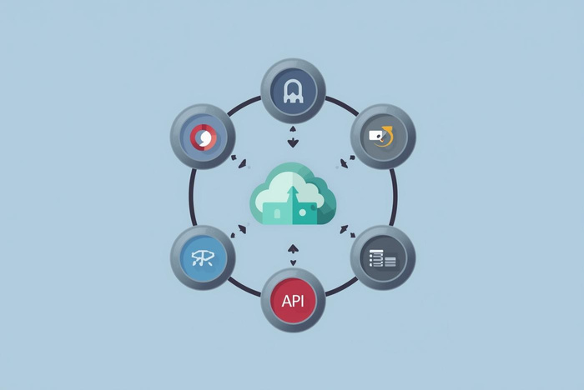

Scraping & API Collection
Scraping Tools
Open Library API
Using requests and BeautifulSoup for efficient data extraction.
Collecting data on trending books through an accessible API.
Goodreads Pages
Respectful Practices
Extracting essential book details from list and book pages.
Implementing pauses and User-Agent for ethical scraping.

Slide 5

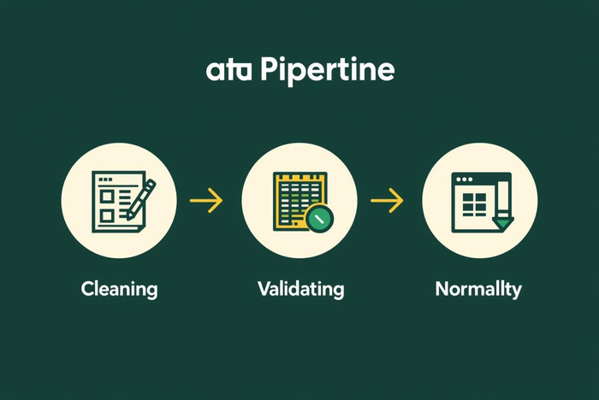
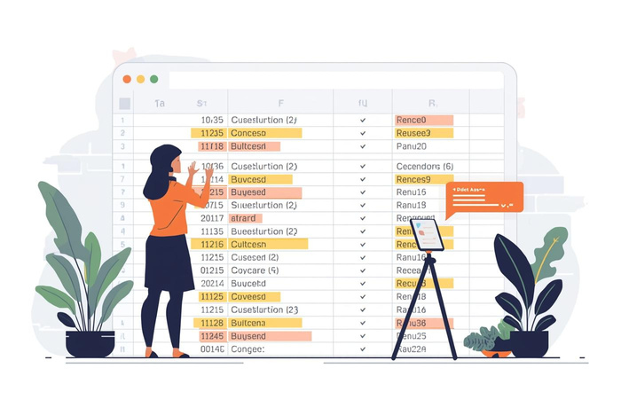
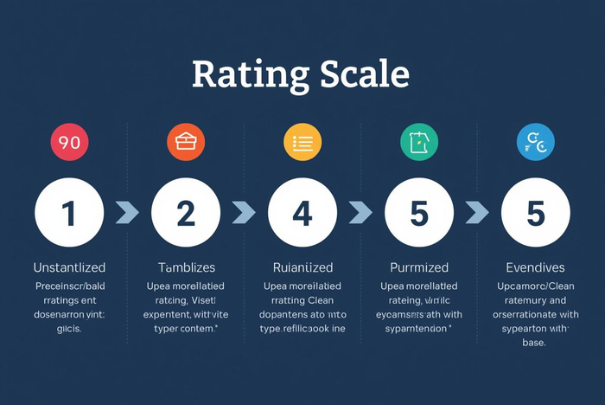
Data Cleaning Steps
Normalize Titles
Drop Missing Rows
“Clean inputs are crucial for good recommendations.”
Clean titles and authors for consistent formatting and accuracy.
Remove entries lacking essential cleaned title or author data.
Normalize Ratings
Clean Ratings Field
Convert all ratings to a consistent numeric scale for analysis.
Ensure the ratings field is free of inconsistencies and errors.

Slide 6
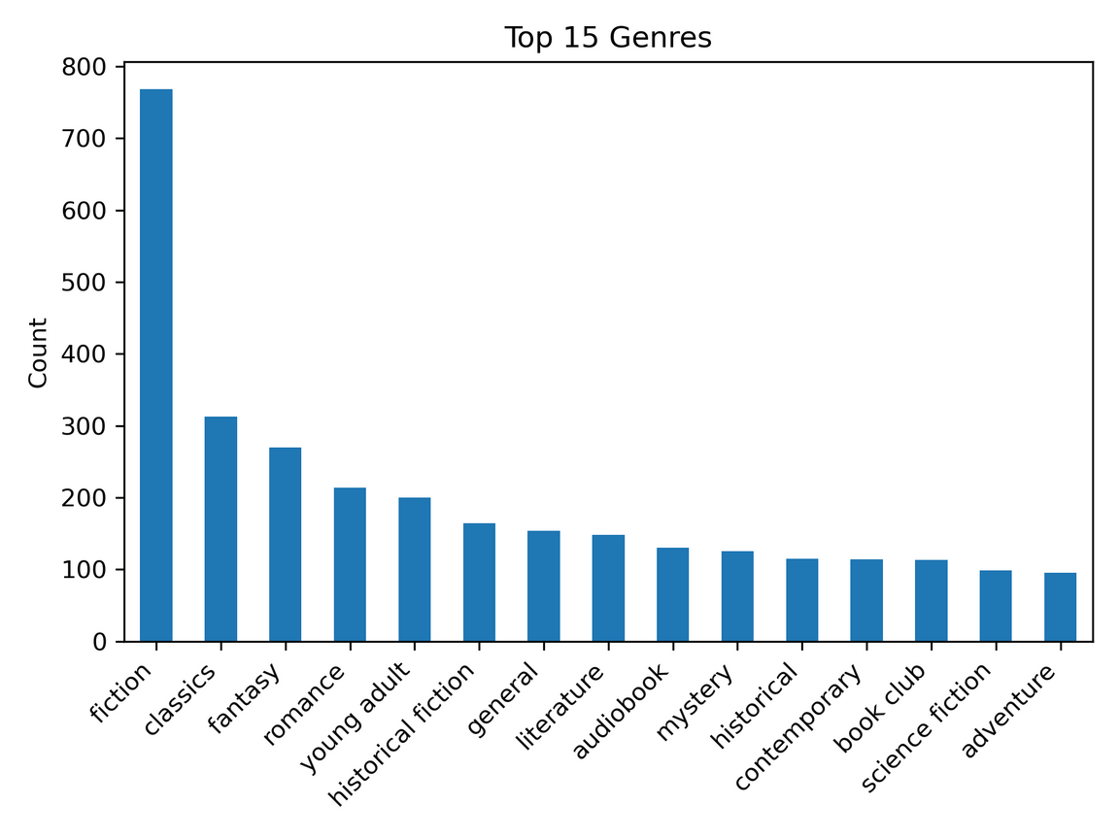
Genre Normalization Process
01
03
Lowercasing ensures consistency across genre entries for better matching.
Removing duplicates per book enhances the accuracy of recommendations.
02
04
Replacing delimiters with separators simplifies the genre categorization process.
Output:
  `genres_list` (clean list)
  `genres_clean` (readable string)

Slide 7
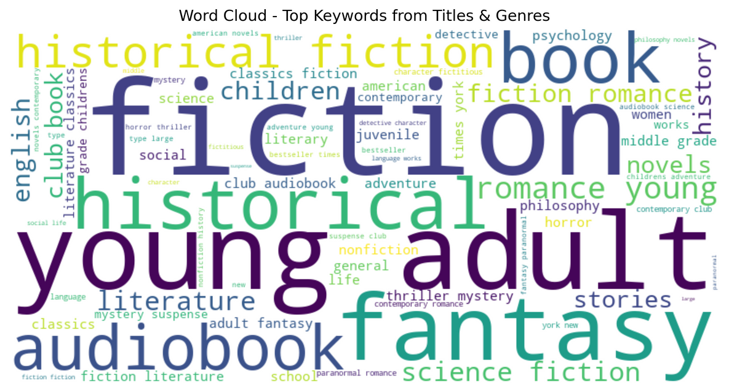
Feature Engineering
TF (Term Frequency):
Words that appear more often in a book’s text are more important for that book.
IDF (Inverse Document Frequency):
Words that appear in many books (like “book”, “novel”) are less special.
TF-IDF is high when:
  A word is frequent in one book’s text.
  But not so common across all books.
Genre Lists & Features
Extracting features is essential for building effective recommendation systems.
Example:
title: "The Hunger Games"
genres: "young adult, dystopia, fiction"
→ "the hunger games [young adult, dystopia, fiction]"
We store this in a column like text_for_keywords.
Why this is useful:
  This gives us one compact “summary text” per book.
  We can feed this into TF-IDF to find meaningful words.

Slide 8
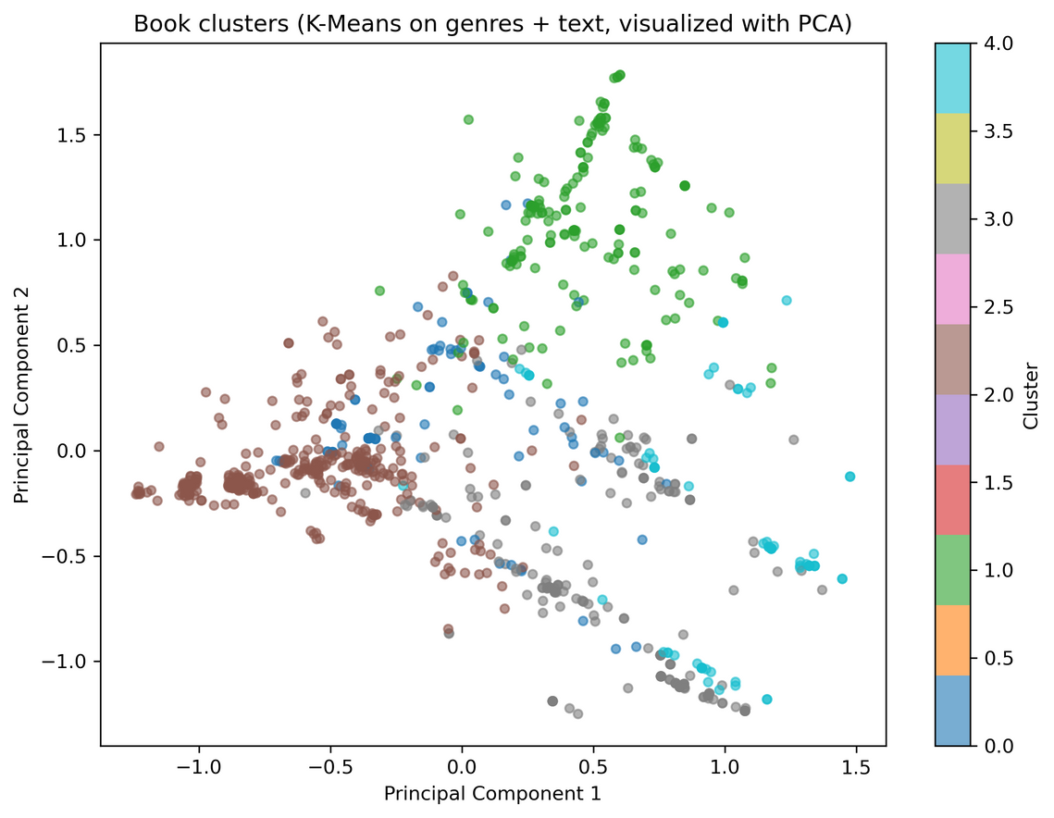
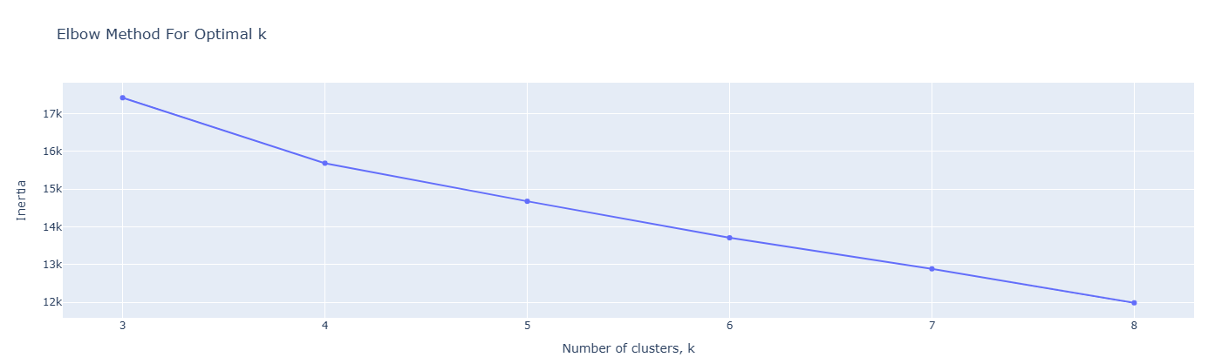
Clustering Process
Unsupervised ML
This technique effectively groups similar books by identifying patterns within features.
k = 3 -> inertia: 17420.98
k = 4 -> inertia: 15686.79
k = 5 -> inertia: 14677.88
k = 6 -> inertia: 13710.35
k = 7 -> inertia: 12888.65
k = 8 -> inertia: 11987.54
cluster_kmeans
0 98
1 184
2 432
3 221
4 75

Slide 9
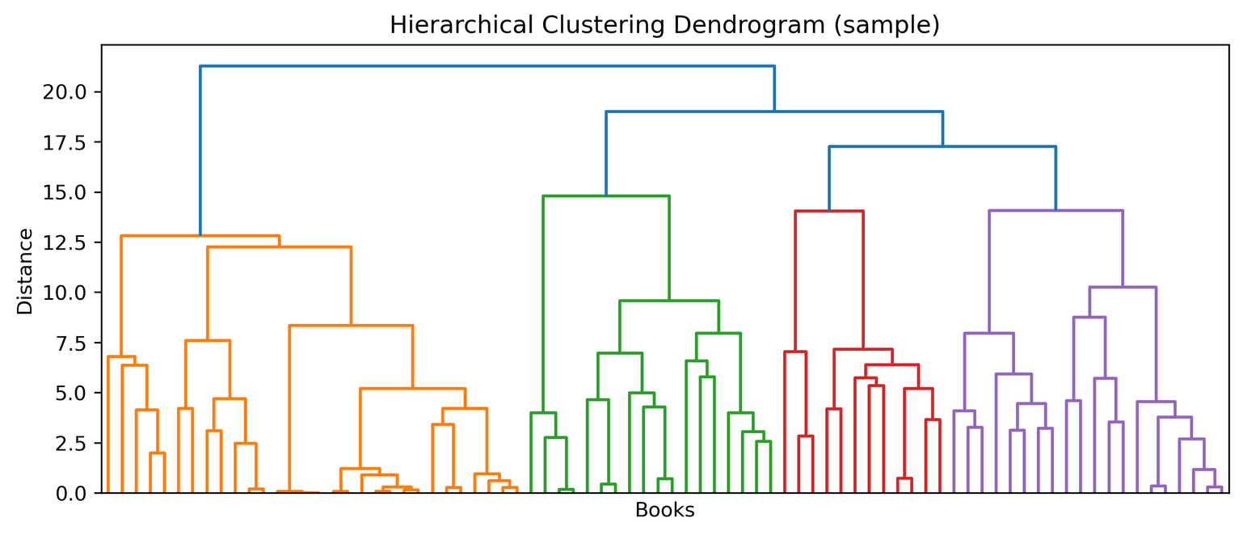
Content-Based Recommender Logic
01
Content-based recommendations leverage book features and clustering information.
02
03
Similarity between books is computed using feature vectors and metrics.
Use cosine similarity:
For a chosen book, find nearest neighbors
Top N most similar = recommendation

Slide 10
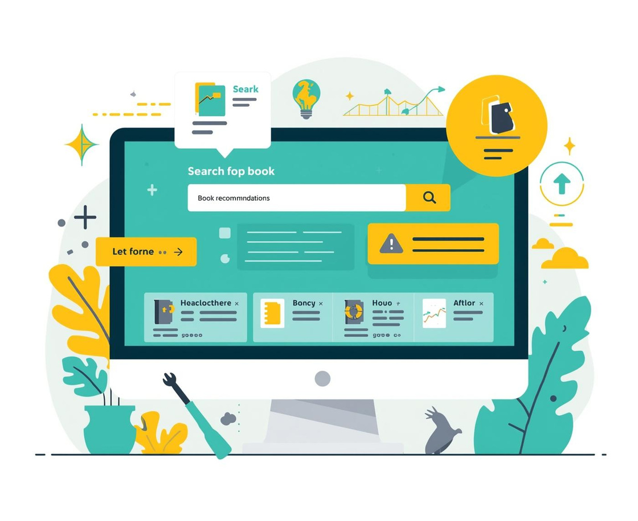


Streamlit Web App Features
Interactive Web App
User-Friendly Features
Deployment Options
Streamlit provides an intuitive platform for creating interactive applications.
Users can search, filter, and find recommendations based on genres.
Deploy your app on any hosting platform or run it locally.

Slide 11
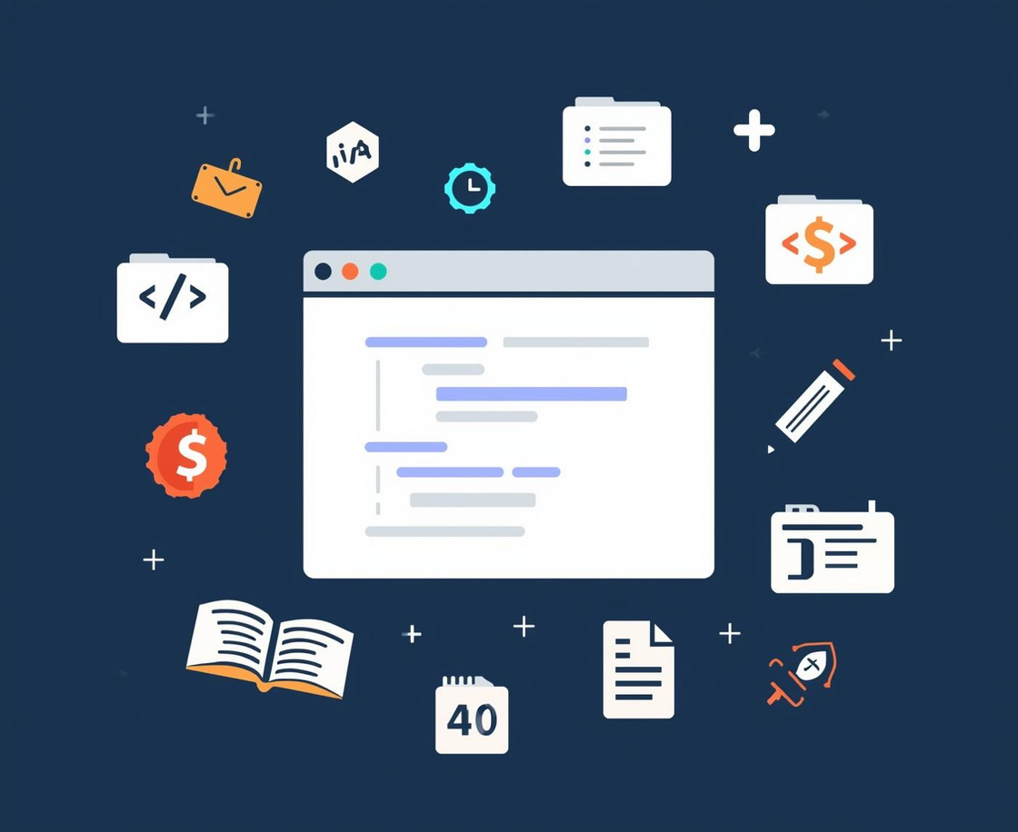
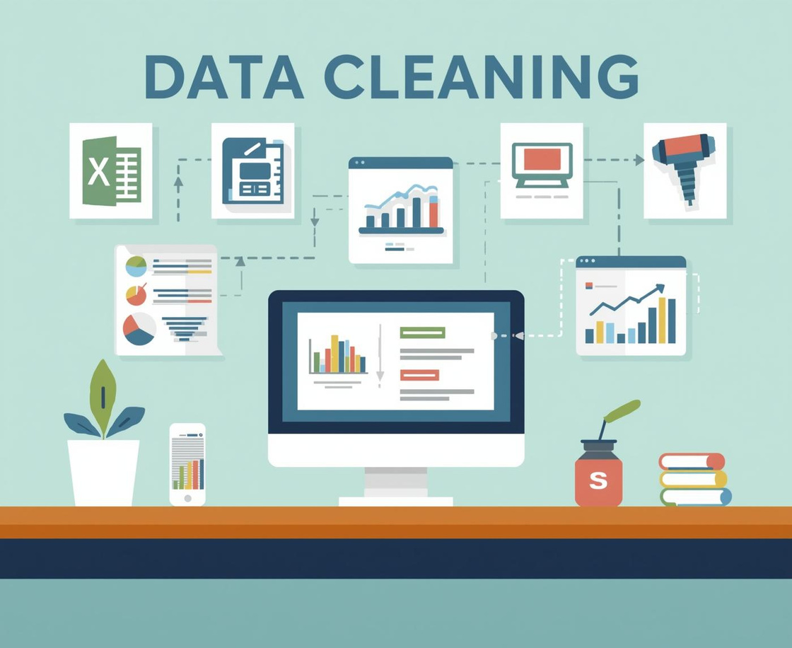
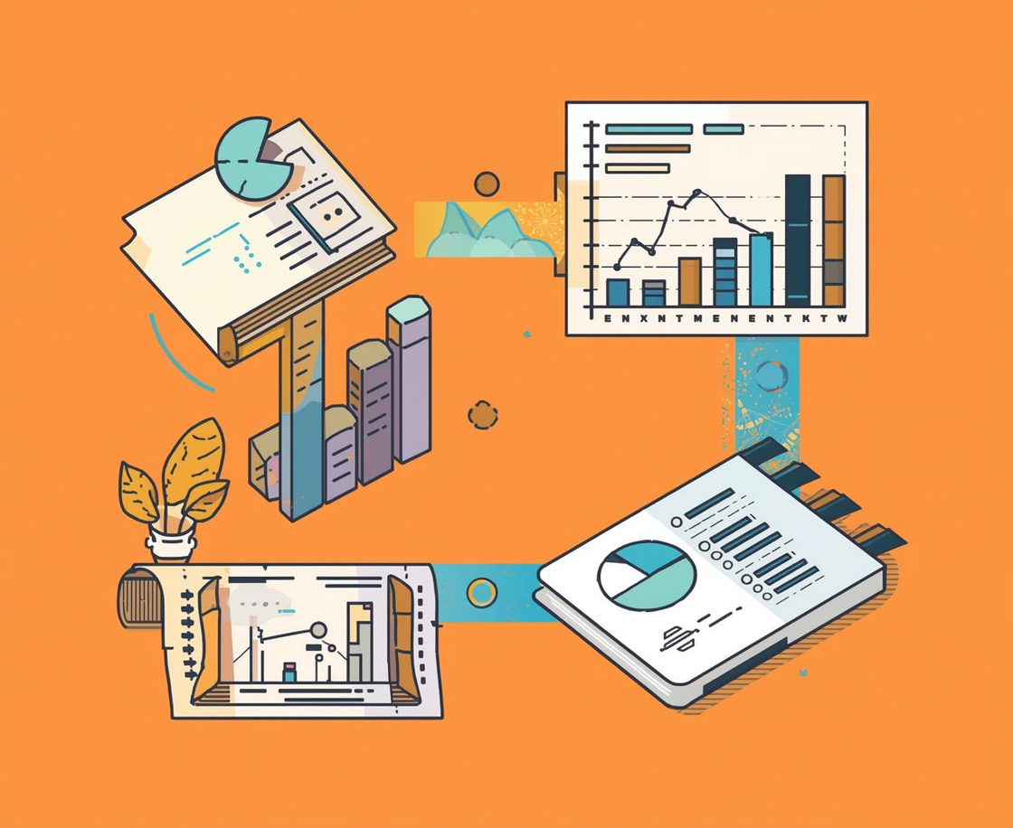
Project Summary
Data Scraping
Data Cleaning
Feature Engineering
Efficient collection of data from multiple sources for analysis.
Thorough process to ensure accuracy and consistency of data.
Transforming raw data into usable formats for recommendations.

Slide 12
Thank You for Your Attention!
Email
hello@reallygreatsite.com
Social Media
@reallygreatsite
Phone
123-456-7890

